Slide 1
Final Assessment Excel
P Vishal Rao
Emp ID - 4406

Slide 2

Case 1
Average value of the column wait has been taken and the average wait time is around 28.10 days

Slide 3
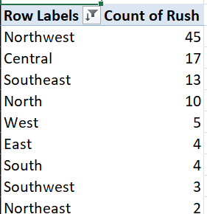
Case 2
Districts are taken as rows in the pivot table and count of rush jobs are taken as values The entire data has been sorted based on the count in descending order Northwest district has the most count of rush jobs

Slide 4
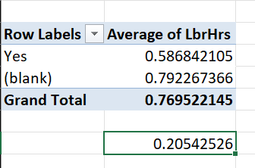
Case 3 Case 3 Case 3
Rush is taken in rows of the pivot table and a average of work hours is taken , Yes is considered as a rush job and blank are considered as a non rush job , taking the average gives us the specific values So the difference in average hours between a rush and non rush job is 0.2054 hrs

Slide 5
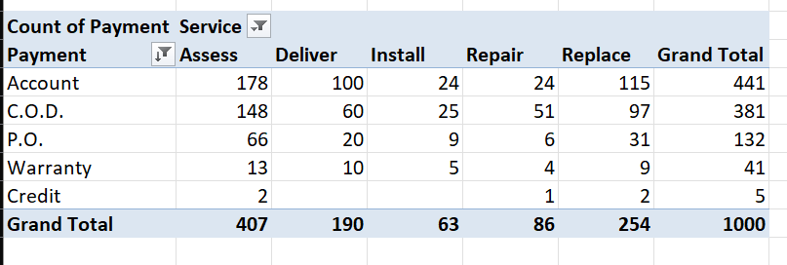
Case 3 Case 3 Case 4
Payment is added in the rows and service type in the column , count of payments has been taken as values in the pivot table .
The distribution is as follow the payment type account has tmost number of transactions , followed by C.O.D cash on delivery . In services Assess has most number of payments followed by replace and deliver

Slide 6
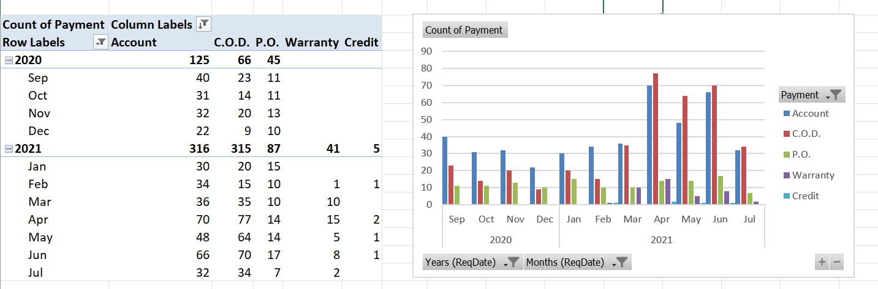
Case 3 Case 3 Case 5
In payment types this is a monthly distribution of payment types we could see that warranty is not that much present in 2020 but had a increase in 2021 , Account payments has seen a significant increase in the year 2021 followed by COD

Slide 7
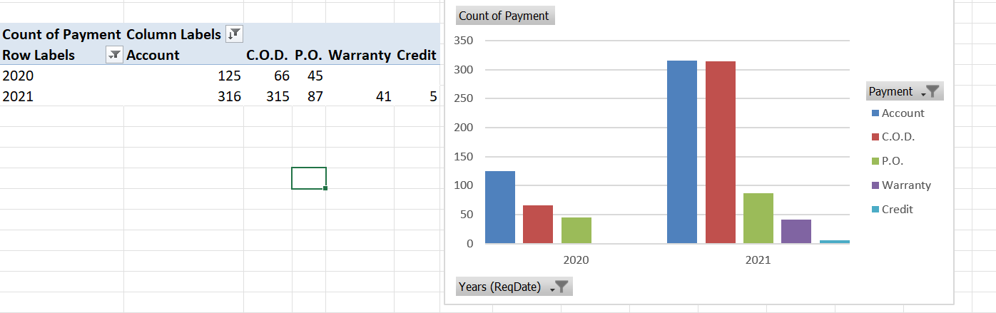
Case 3 Case 3 Case 5-part 2
Year wise analysis we can find that warranty and credit didn’t have much data in 2020 , but we started to get data i.e usage of warranty and credit can be seen from 2021

Slide 8
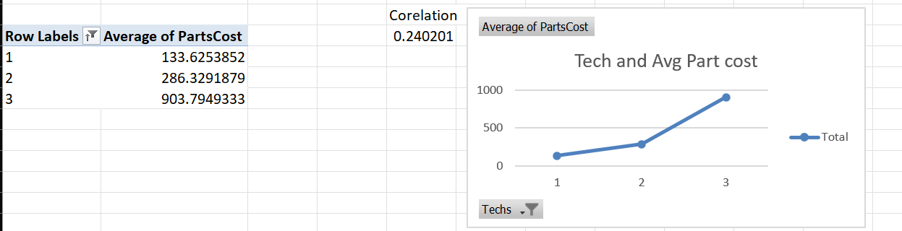
Case 3 Case 3 Case 6
As we could see from the chart the as the number of technicians required have increased the avg cost of parts are also increased Correlation of the column tech and partscost has been calculated which gave a value of 0.24021 , which states that there is a positive relationship between tech and partscost

Slide 9
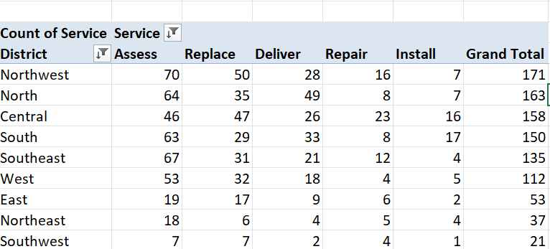
Case 3 Case 3 Case 7
The northwest region has the most number of services with the total of 171 when compared to other districts. The most common service in the Northwest district is the Assess with 70 , followed by Replace with 50 .

Slide 10
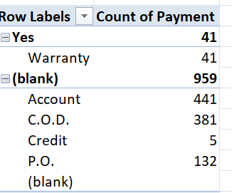
Case 3 Case 3 Case 8
Yes is warranty labour is considered and the other is warranty labour not considered. We could clearly see the distribution of payment types with warranty , there is no other type of payment form used.
Without warranty we could see different payment types as account , C.O.D , P.O Yeah there is a difference in payment distribution when warranty is considered

Slide 11
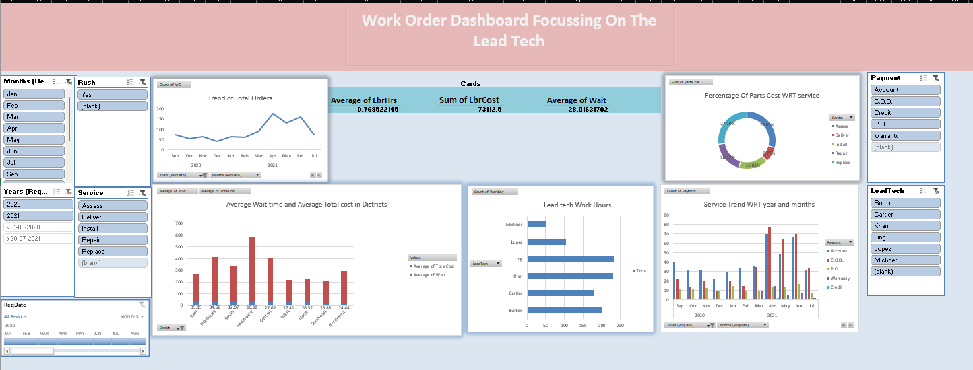
Case 3 Case 3 Dashboard
This is the Work Order Dashboard with the focus on the lead techs performance in the two years. This dashboard focuses on the yearly performance and services with the cost and wait of Lead Techs

Slide 12
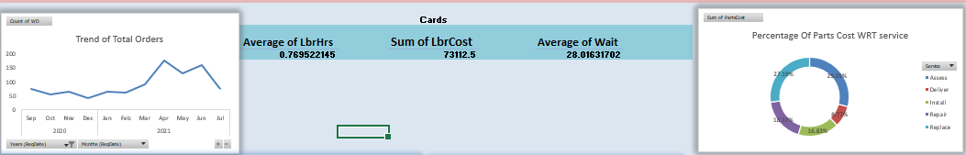
Case 3 Case 3 Dashboard Charts
The trend of total number of orders in the period of 2020- 21 which further is divided into month The next part contains Cards which are dynamically changed by the slicer values The doughnut chart consists of percentage cost of parts with respect to the service provided , it tells us the cost of parts in each kind of service

Slide 13
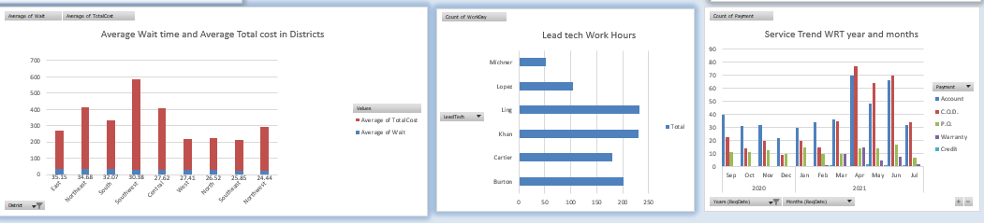
Case 3 Case 3 Dashboard Charts
The first chart is a stacked bar chart which gives us the information about average wait days and average total cost in each regions Next is the Lead tech work hours w.r.t to months or years The next chart is the service trend w.r.t to years and months , which is represented by
a grouped chart. This shows us the t

Slide 14
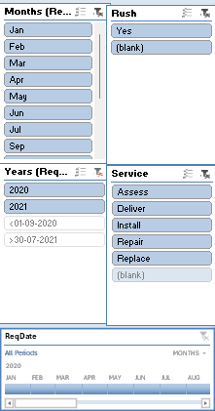
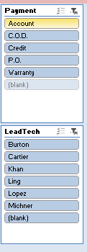
Case 3 Case 3 Slicers
The slicers contain the columns Months,Rush Hour or not ,Years, Service Type , Timeline ,Payement and Lead Tech Each and every slicers are connected to the charts which would help in an in depth analysis of the working hours , avg wait and cost of the lead techs

